Slide 1
Welcome
Acts and the Survey of NT Epistles

Slide 2
Purpose of Acts
Spread of Christianity
Centrality of Christ
Unity of the Holy Spirit
Sovereign nature of the gospel
Supernatural nature of the faith

Slide 3
Purpose of Acts
Vindicate mission of the church
Historical roots of the church
Explain universality of church
Authenticate Paul’s apostleship
The Kingdom of God

Slide 4
Central idea of Acts
“To explain the continued work and witness of Jesus Christ by the Holy Spirit through the apostles throughout the world.”

Slide 5
Theme & Structure:
Centrality of Jesus Christ
Presense and Power / HS
Extension of the Church

Slide 6
Theme & Structure:
Opposition
Geographical progression
Nine progress reports

Slide 7
Theme & Structure:
Key elements:
Person - Jesus Christ
Power - Holy Spirit
Program - witnesses
Plan - Jerusalem, Judea and Samaria, to ends of the earth

Slide 8
Theme & Structure:
Central Idea: Acts 1:8
But you will receive power when the Holy Spirit comes upon you: and you will be my witnesses in Jerusalem, and in all Judea and Samaria, and to the ends of the earth.

Slide 9
In all Judea and Samaria
Philip to -Samaria, Gaza, Caesarea
Peter to - Samaria, Caesarea, Jerusalem
Paul to - Jerusalem, Damascus, Tarsus, Antioch

Slide 10
GUIDING OUTLINE
Prologue & Preparation Acts 1
In Jerusalem Acts 2-8:3
In Judea and Samaria Acts 8:4-12
To the ends of the Earth Acts 13-28

Slide 11
STRUCTURE - NINE REPORTS
1:1-5 - Starting point
2:47 - After G/HS at Pentecost
4:31-35 - After initial opposition
6:7 - Deacons added and
Religious conversions
9:31 - Martyrdom, Samaria,
Conversion of Saul

Slide 12
STRUCTURE - NINE REPORTS
12:24 - The move of the center of
gravity to Antioch (missions)
16:5 - Expansion into Europe
19:20 - Climax of Paul’s ministry
in Ephesus
28:28-31 - Paul in Rome,
teaching “unhindered”

Slide 13
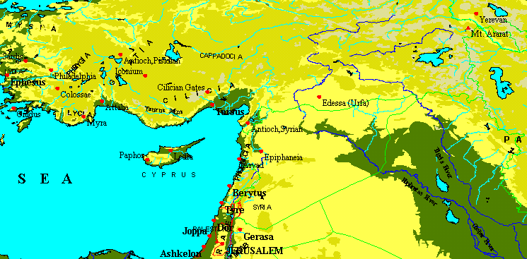
Antioch: city at the center of change

Slide 14
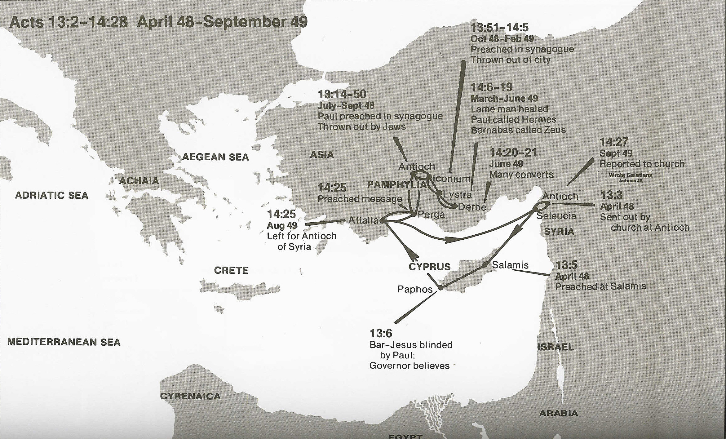
John Mark returns to Jerusalem (Acts 13:13).
First Missionary Journey
Wilkerson & Boa

Slide 15
STRUCTURE - NINE REPORTS
12:24 - The move of the center of
gravity to Antioch (missions)
16:5 - Expansion into Europe
19:20 - Climax of Paul’s ministry
in Ephesus
28:28-31 - Paul in Rome,
teaching “unhindered”

Slide 16
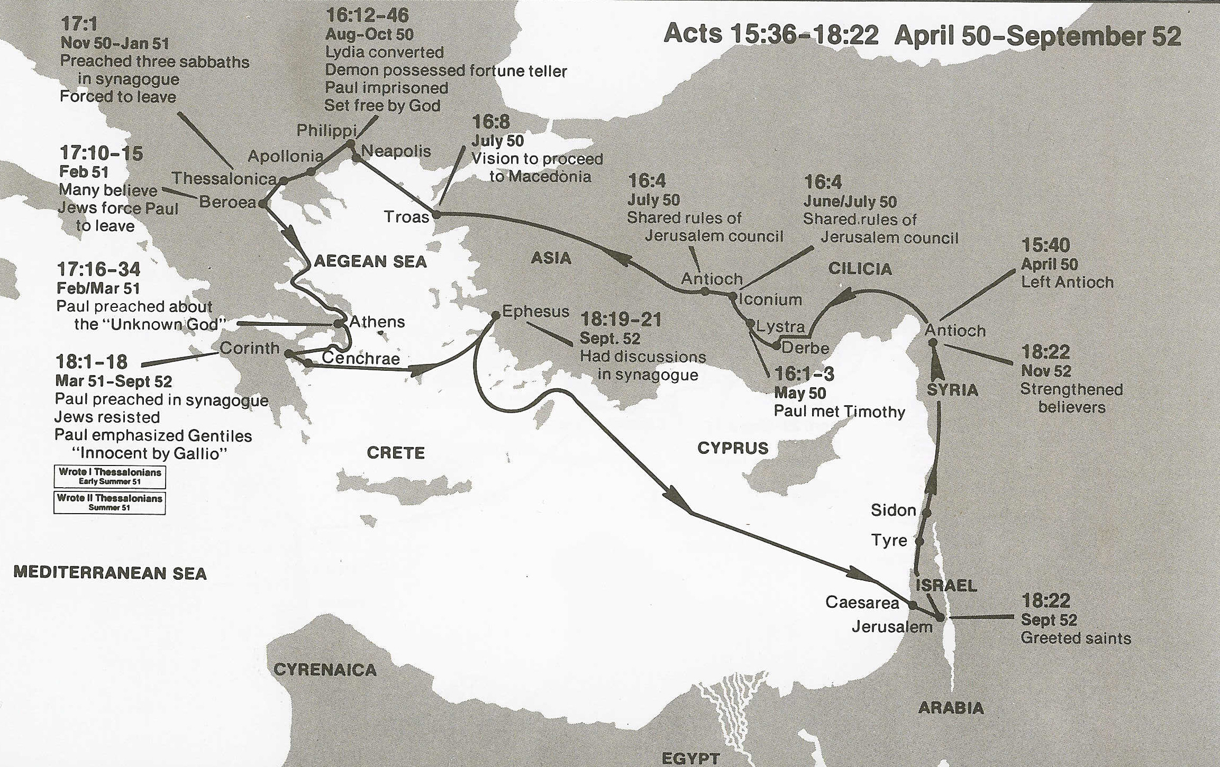
(1 Thes. 1:1; 2:17; 3:6–10; 2 Thes. 1:1)
Second Missionary Journey
Wilkerson & Boa

Slide 17
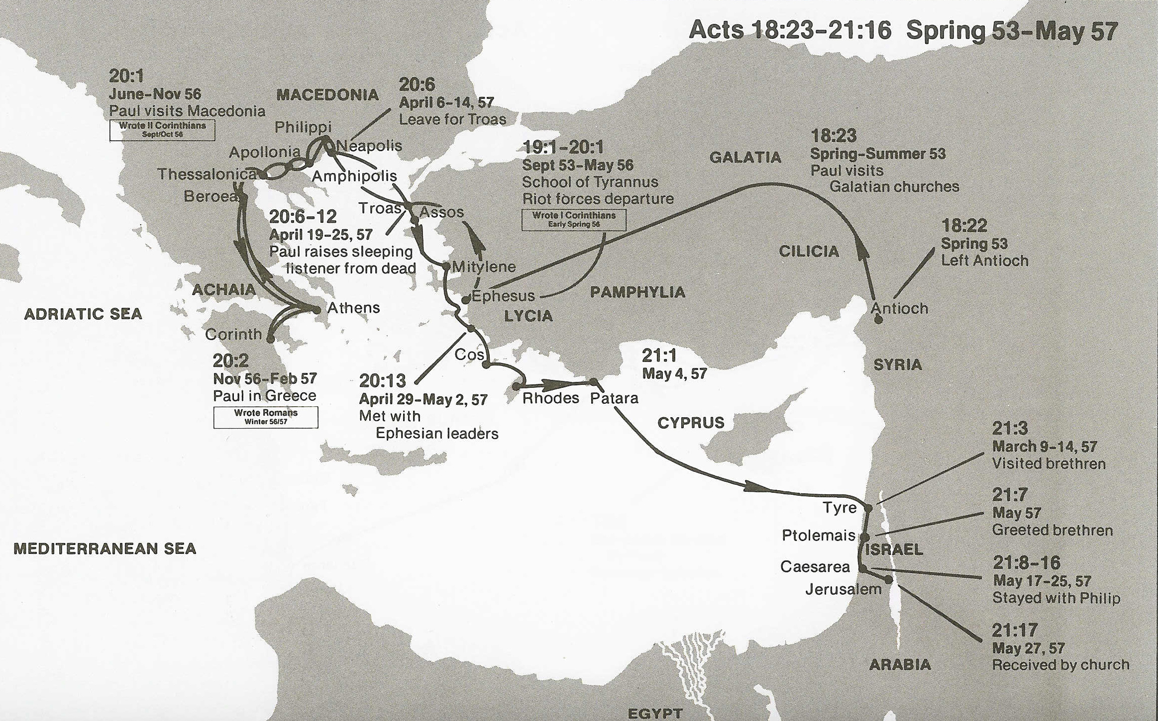
Third Missionary Journey
Wilkerson & Boa

