Slide 1
Welcome
Acts and the Survey of NT Epistles

Slide 2
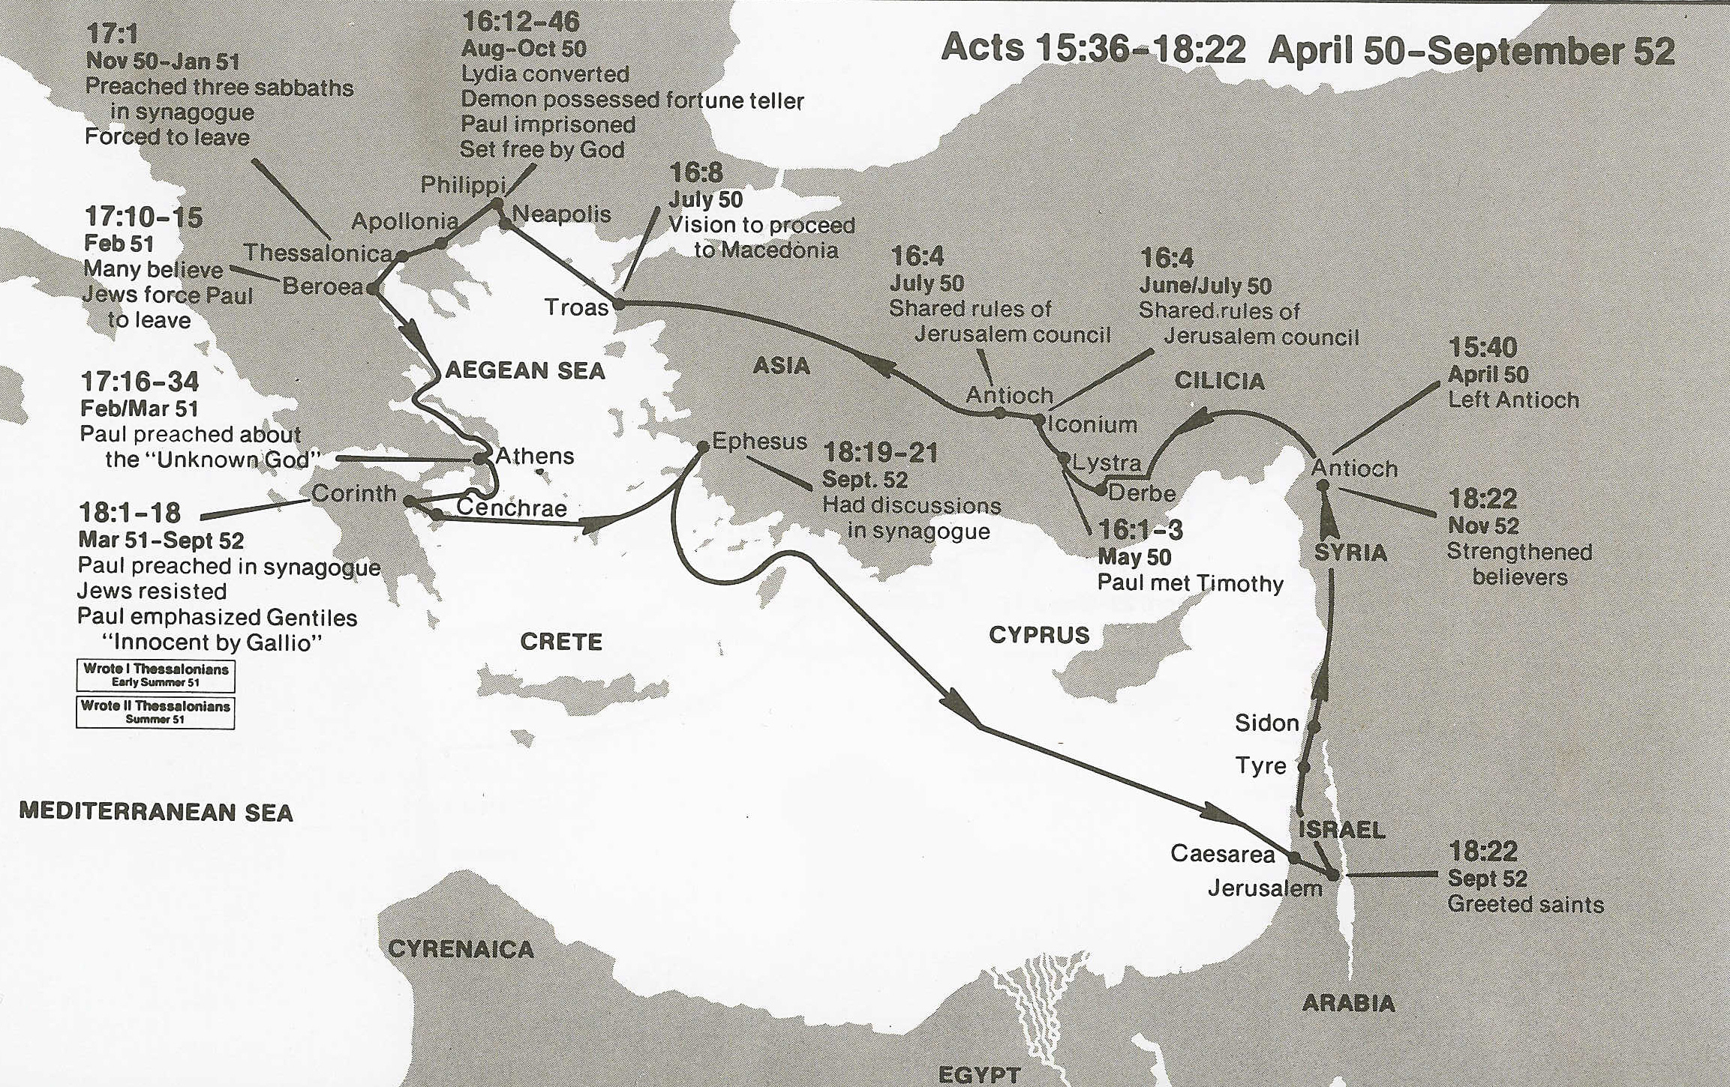
Philippi
Troy
(1 Thes. 1:1; 2:17; 3:6–10; 2 Thes. 1:1)
Second Missionary Journey
Wilkerson & Boa

Slide 3
Terms
Personnel
Combat characteristics
Teamwork
Leadership qualities
Military operations
Roman colony
“Esprit de corps”

Slide 4
Theme - Phil 1:9-11
9 And this I pray, that your love may abound still more and more in real knowledge and all discernment, 10 so that you may approve the things that are excellent, in order to be sincere and blameless until the day of Christ; 11 having been filled with the fruit of righteousness which comes through Jesus Christ, to the glory and praise of God.

Slide 5
Theme Outline
I. Approve what is excellent
II. Excellent qualities of unity and humility
III. True excellence vs. false
IV. Exhortation and provision for excellence.

Slide 6
Theme Outline
I. Approve what is excellent
v1 - to leaders
v6-11 - approve what is excellent
v12-17 - greater progress of the gospel
in my suffering
V18-26 - to live or die? - To live
v27-30 - unity, courage, suffering,
my example

Slide 7
Theme Outline
II. Excellent qualities of unity and humility
v1-4 - excellent qualities to imitate
v5-11 - example of Christ Jesus
v12-16 - obey in God’s work
without complaint
v17-18 - Paul’s example
v19-24 - Timothy’s example
v25-30 - Epaphroditus’ example

Slide 8
Theme Outline
III. True excellence vs. false
v1-11 - True +R vs. False +R
v12-16 - Continue to mature
v17-21 - “Follow me!”

Slide 9
Theme Outline
IV. Exhortation and provision for excellence.
v1 - stand firm
v2 - harmony and unity
v3 - help others
v4 - rejoice, always rejoice
v5 - express gentleness
v6 - no anxiety
v7 - peace in decisions and thinking
v8-9 - excellent things

Slide 10
Theme Outline
IV. Exhortation and provision for excellence.
V10 - need for opportunity
v11-12 - need to be content
v13 - God’s strength
v14 - sharing in suffering
v15-18 - monetary gift
v19 - God will supply all needs

