Slide 1
Welcome
Acts and the Survey of NT Epistles

Slide 2
Central idea of Acts
“To explain the continued work and witness of Jesus Christ by the Holy Spirit through the apostles throughout the world.”

Slide 3
Synthetic Chart of the Book of Acts
Growth of the Church
FIRST MISSIONARY
JOURNEY
13:1 – 14:28
Barnabas & Paul
SECOND MISSIONARY
JOURNEY
15:36 – 18:22
Paul & Co.
TO THE UTTERMOST
Paul & Others
JERUSALEM COUNCIL
James & Paul – Acts 15 “Through Faith Alone”
THIRD MISSIONARY
JOURNEY
18:23 – 21:16
Paul & Co.
JOURNEY TO ROME
21:17 – 28:31
Paul
JUDEA & SAMARIA
Philip & Peter – Acts 8-12
JERUSALEM
Peter – Acts 1-8
The Great Commission
In action
Acts 1:8

Slide 4
Characteristics and Trends Noticeable in the Jerusalem Period of the Church
1. The prominence of Peter, his leadership, and his speeches are dominant (1:15–22; 2:14–40; 3:4, 12–26; 4:8–12; 5:3, 15, 29–32).
2. The ministry of the Holy Spirit is emphasized (1:4, 5, 8; 2:1–21; 4:8, 31; 5:32; 6:3, 10; 7:55).
3. The church is marked by unity, love, power, prayer, willingness to suffer, joyous praise, and enthusiasm (2:42–47; 4:32–35; 5:12–16, 41–42).
4. The persecutions were all effected by Jews, and in particular the Sadducees (4:1, 2; 5:17; 6:12).

Slide 5
Characteristics and Trends Noticeable in the Jerusalem Period of the Church
5. The gospel was preached mainly to Jews.
6. There is evidence of a growing intensity of persecution (4:3, 13; 5:18, 29; 8:1–3).
7. The church grew very quickly (1:5; 2:41; 4:4; 5:14; 6:7).
8. The beginnings of sin and dissension appear in the church (5:1–11; 6:1).
9. It was a period of laying the foundation, consolidation, and preparing an army of witnesses who were to broadcast the Word throughout the Middle East and eventually the known world (8:4).

Slide 6
How does Acts 1—7 prepare us for 8—11?
With the end of chapter 7, the first period of church history comes to a close.
With the beginning of chapter 8, we observe a marked change in the life and ministry of the church.
There is a geographical expansion.
There is also a transformation of missionary methods.
There is the beginning of the development of Christianity into a world–wide religion.

Slide 7
III. THE SCATTERED WITNESS: THE DIRECTION AND DIRECTOR, 8:1b—9:31
Rise of Persecution, 8:1b-3
Philip in Samaria, 8:4-25
Philip Preaches to an Ethiopian, 8:26-40
The Apostle to Gentiles is Saved, 9:1-31
Saul’s Salvation, 9:1-19a
Saul’s Persuasiveness, 9:19a-22
Saul’s initial persecutions, 9:23-31

Slide 8
In all Judea and Samaria Acts 8-12
Three men
Three missions
One message
Philip
Peter
Paul

Slide 9
Diasparesan = dia- “through”, speiro- “sow” “to sow by scattering seed abroad”
“Christians are not distinguished from the rest of mankind by either country, speech, or customs….They reside in their respective countries, but only as aliens. They take part in everything as citizens and put up with everything as foreigners. Every foreign land is their home, and every home a foreign land…. They find themselves in the flesh, but do not live according to the flesh. They spend their days on earth, but hold citizenship in heaven.” Epistle to Diognetus, anon. Second Century

Slide 10
Rise of Persecution, 8:1b-3
Content to limit their activities to Jerusalem during the period of foundation and consolidation.
Now, time for expansion.
Persecution became the driving force.
The result - fulfill Acts 1:8.
Samaria, Phoenicia, Syria, Cyprus, and even to Cilicia.
The inclusion of uncircumcised Gentiles.

Slide 11
Deacons, 6:5
Stephen - “crown”
Philip - “lover of horses”
Prochorus - “leader of a chorus”
Nicanor - “victorious;” “conqueror”
Timon - “worthy”
Parmenas - bishop of Soli, martyr
Nicolas - “conqueror of the people,” Rev 2

Slide 12
Philip in Samaria, 8:4-25
Why is Samaria significant?
In 722 B.C. when Assyria took the Northern Kingdom into captivity, the higher class Israelites were deported, and foreign captives were imported in their place.
The mingling of these foreigners with the poorer class of Israelites produced the people known as Samaritans.
The preaching of the gospel to these people was the first step away from evangelizing none but Jews only.
Notice that Peter used the keys (Matt. 16:18–19) here as he did in Acts 2 and 10.

Slide 13
Simon’s reprimand, 8:18-24
Simon Magus became a figure of considerable importance in early church history.
The father of heresy, founder of Gnosticism.
The sect of Gnostics refuted by Irenaeus in his work Against Heresies.

Slide 14
Philip Preaches to an Ethiopian, 8:26-40
A Gentile by blood, an Ethiopian.
He was not category = uncircumcised Gentile.
Proselyte to Judaism.
No question about his inclusion, as with Cornelius’ conversion (cf. Acts 11).
His conversion was another step toward the inclusion of Gentiles without prerequisites.

Slide 15
Saul’s background, 9:1-31
Hometown Tarsus in Cilicia (Acts 22:3).
Pure–blooded Israelite (Phil. 3:5, 6).
Roman citizen by birth (Acts 22:25, 28).
Born around A.D. 1.
Son of a Pharisee (Acts 23:6).
Student of Gamaliel (Acts 22:3).
A strict Pharisee (Phil. 3:5; Acts 26:5) and a rabbi (Acts 13:15, 16).

Slide 16
Critic’s view of Paul’s conversion
Thorn in the flesh = epilepsy and subject to hallucinations.
Visions of 2 Corinthians 12:1–8 are mentioned in connection with the thorn in the flesh.
Also includes a thunderstorm in the conversion experience.
Therefore, conversion completely on a psychological basis with following elements:
(1) teaching of Gamaliel, Acts 5:34–39;
(2) martyrdom of Stephen, Acts 7:58;
(3) growing madness of Saul as a persecutor, Acts 8:3; 9:1.

Slide 17
Saul’s Salvation, 9:1-19a
The traditional view of the conversion:
Actual sight of the risen Christ, not a thunderstorm of hallucination.
Paul experienced an instantaneous and supernatural regeneration.
Paul influenced by Stephen’s logic and his unique death.
He was convicted but he rebelled (“kicked against the pricks,” Acts 26:14).

Slide 18
The significance of Saul’s conversion:
Luke introducing the second main character.
Significant step in the preparation for carrying the gospel to the Gentiles.
Ananias is told that Paul will be a witness to Gentiles (Acts 9:15).
Timeliness - Just at the time when the door is being opened to the Gentiles, the Lord selects the chief instrument to be used in the Gentile missionary movement.

Slide 19
In all Judea and Samaria Acts 8-12
Three men
Three missions
One message
Philip
Peter
Paul

Slide 20
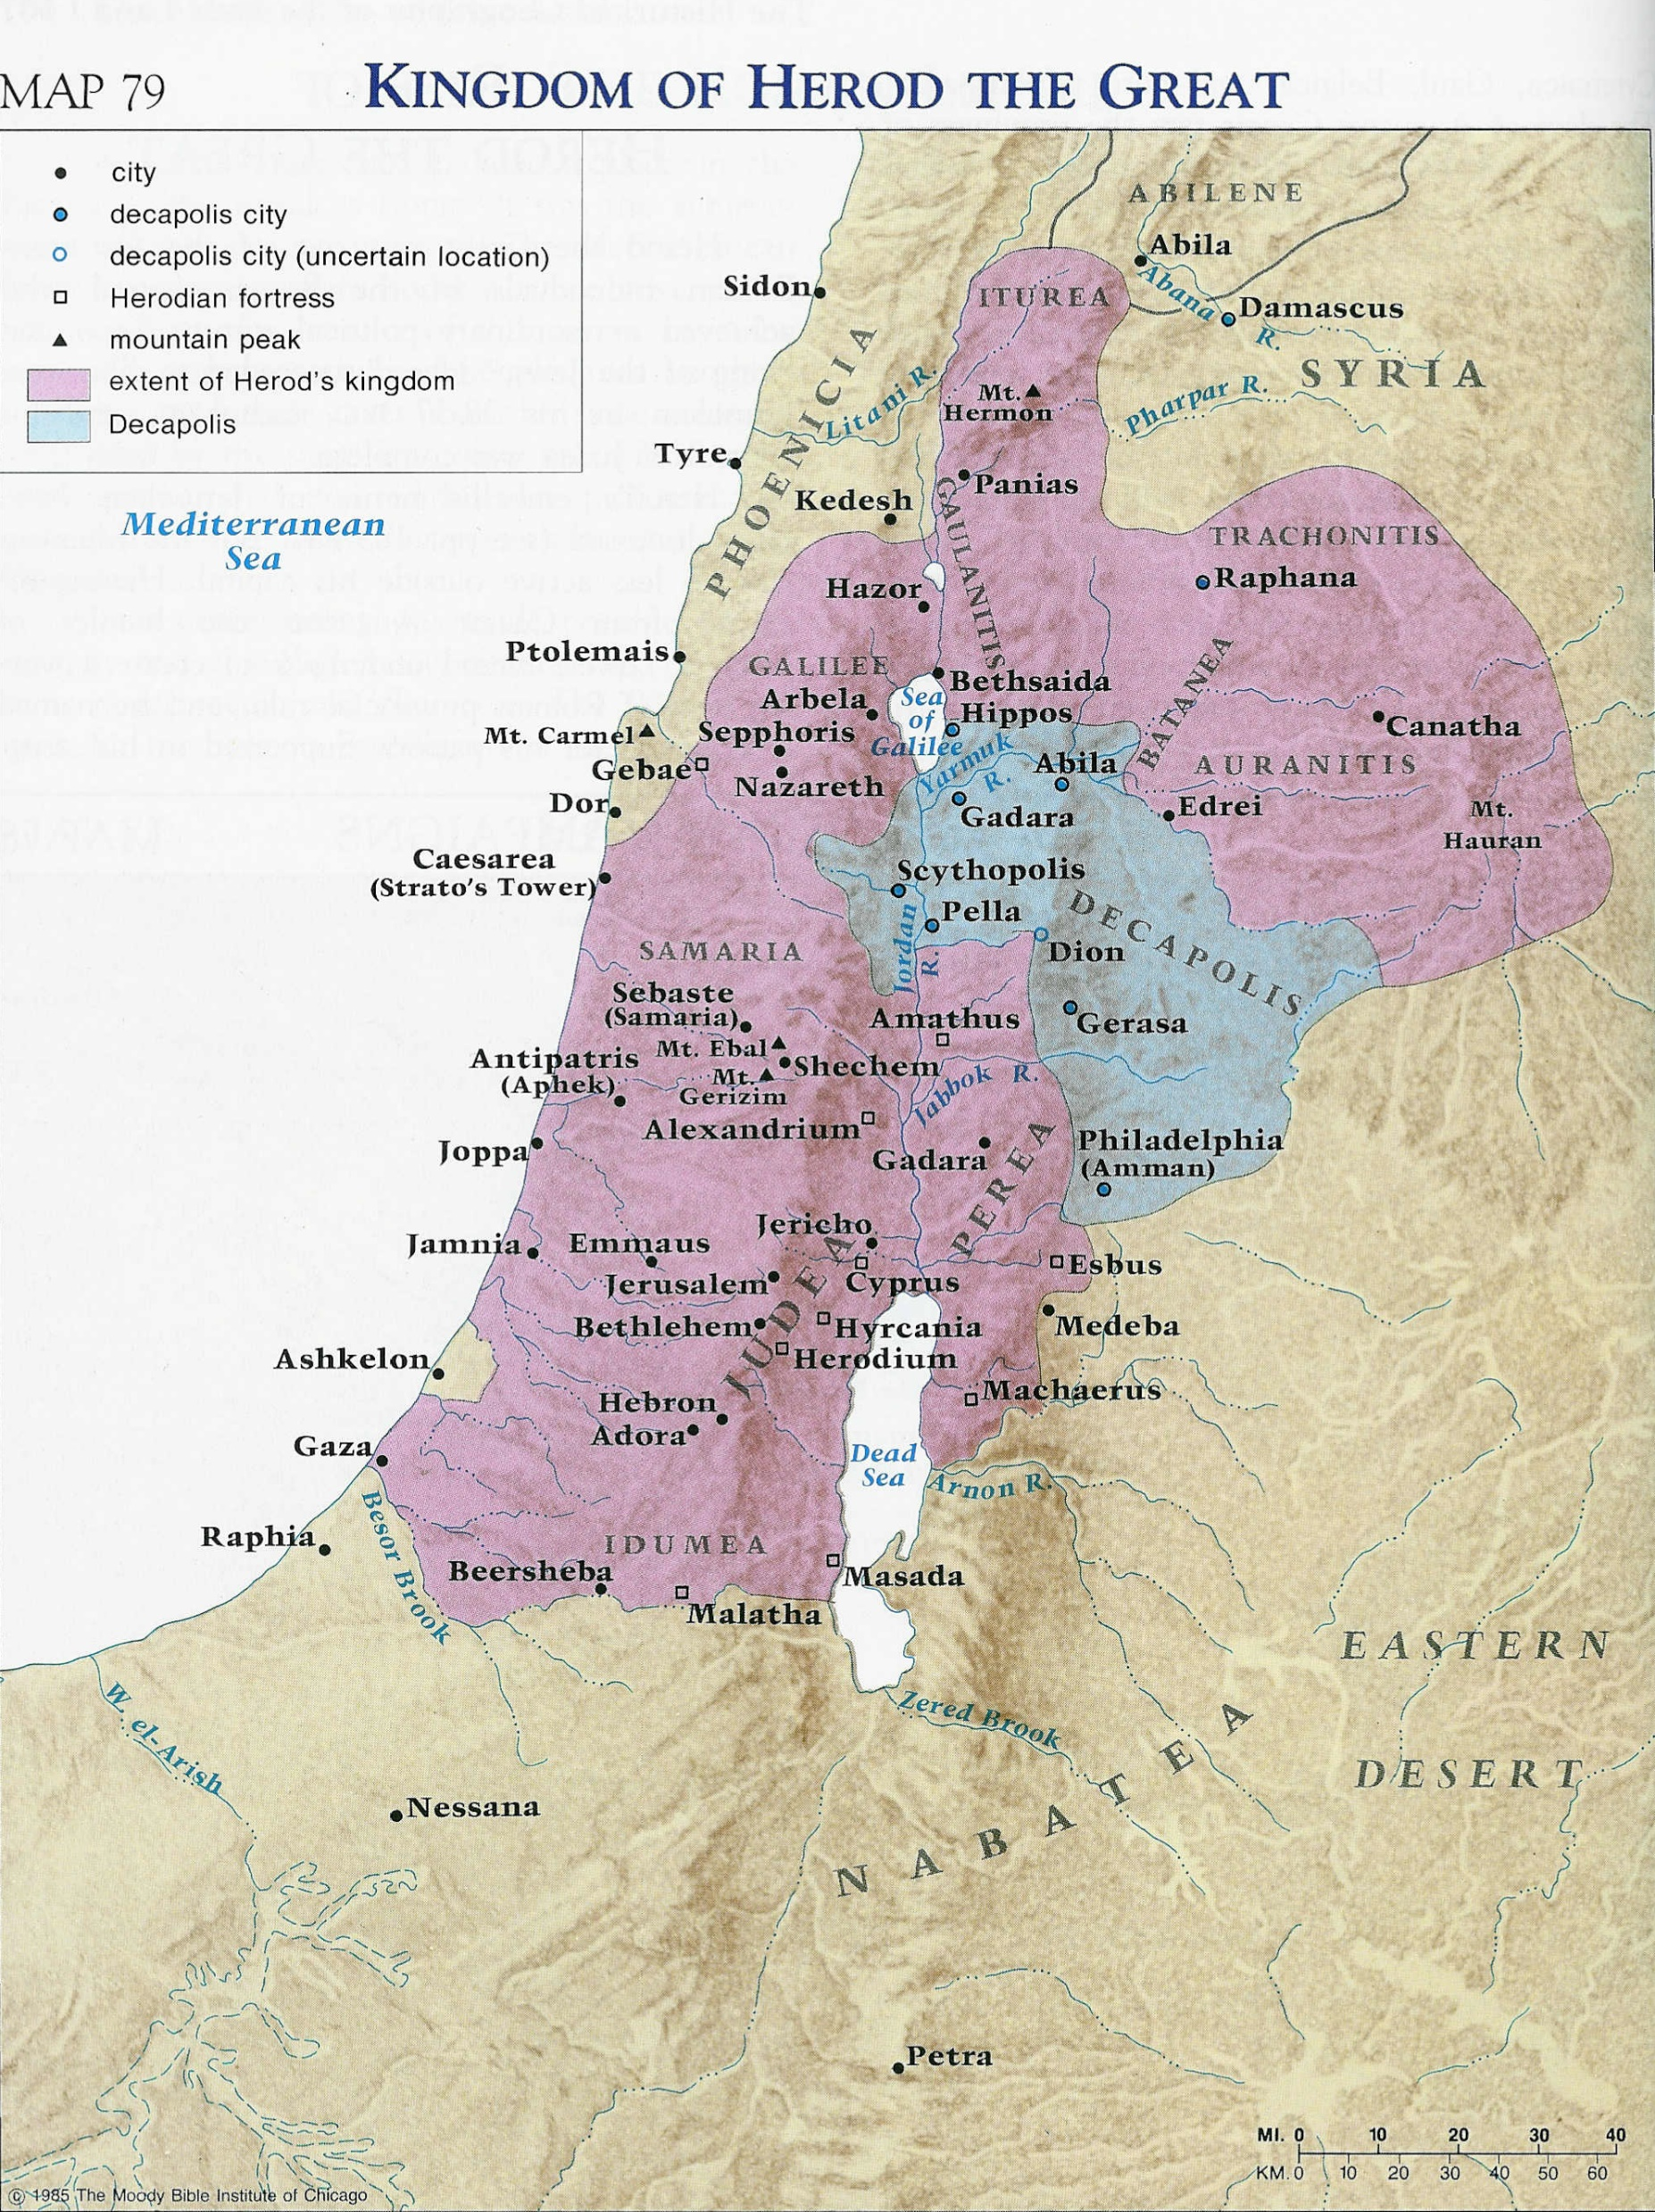

Slide 21
Saul’s History
AD 33/34 - Damascus a few days (Acts 9:19–22)
AD 34-37 - withdrew to Arabia (Gal. 1:17).
Return to Damascus (Gal. 1:17; Acts 9:23–25).
AD 37 - Made a 15–day visit to Jerusalem (Gal. 1:18; Acts 9:26–29).
AD 37-46 - Return to Tarsus for some years (Acts 9:30; Gal. 1:21).
AD 47 - He was called by Barnabas to help at Antioch (Acts 11:25, 26).
AD 48 - Second journey to Jerusalem with relief for famine–stricken saints (Acts 11:29, 30; 12:25). Perhaps the Jerusalem visit recorded in Gal. 2:1–10.

