Slide 1
Welcome
Acts and the Survey of NT Epistles

Slide 2
Saul’s Salvation, 9:1-19a
The traditional view of the conversion:
Actual sight of the risen Christ, not a thunderstorm of hallucination.
Paul experienced an instantaneous and supernatural regeneration.
Paul influenced by Stephen’s logic and his unique death.
He was convicted but he rebelled (“kicked against the pricks,” Acts 26:14).

Slide 3
The significance of Saul’s conversion:
Luke introducing the second main character.
Significant step in the preparation for carrying the gospel to the Gentiles.
Ananias is told that Paul will be a witness to Gentiles (Acts 9:15).
Timeliness - Just at the time when the door is being opened to the Gentiles, the Lord selects the chief instrument to be used in the Gentile missionary movement.

Slide 4
In all Judea and Samaria Acts 8-12
Three men
Three missions
One message
Philip
Peter
Paul

Slide 5
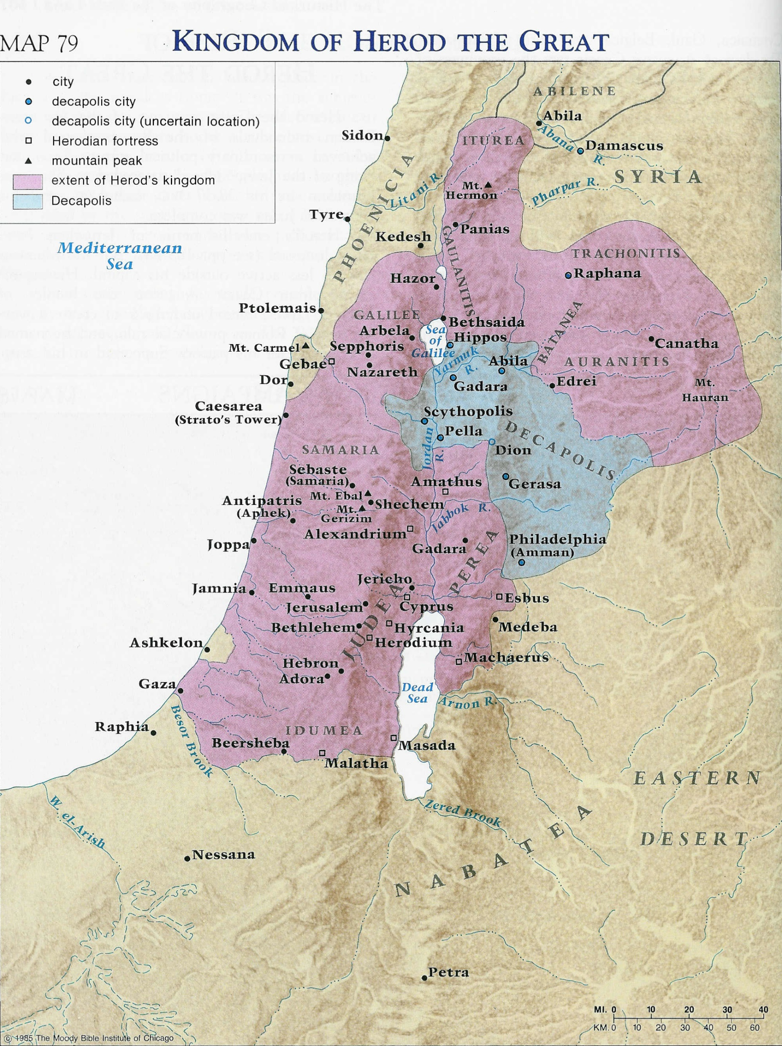

Slide 6
Saul’s History
AD 33/34 - Damascus a few days (Acts 9:19–22)
AD 34-37 - withdrew to Arabia (Gal. 1:17).
Return to Damascus (Gal. 1:17; Acts 9:23–25).
AD 37 - Made a 15–day visit to Jerusalem (Gal. 1:18; Acts 9:26–29).
AD 37-46 - Return to Tarsus for some years (Acts 9:30; Gal. 1:21).
AD 47 - He was called by Barnabas to help at Antioch (Acts 11:25, 26).
AD 48 - Second journey to Jerusalem with relief for famine–stricken saints (Acts 11:29, 30; 12:25). Perhaps the Jerusalem visit recorded in Gal. 2:1–10.

Slide 7
In all Judea and Samaria
Philip to -Samaria, Gaza, Caesarea
Peter to - Samaria, Caesarea, Jerusalem
Paul to - Jerusalem, Damascus, Tarsus, Antioch

Slide 8
IV. THE GENTILES: DIVINE INCLUSION, 9:32–11:26
Two Miracles in Neighboring Towns, 9:32-43
Confirmation of Gentile Salvation, 10:1–11:30

Slide 9
The conversion of Cornelius (10:1 - 48)
Cornelius - uncircumcised Gentile (11:2, 3).
He was not a Jewish proselyte indicated by criticism against Peter (chapter 11).
Peter was reluctant to take the gospel to the Gentiles (Acts 10:14).
Timing of events. (v17)
The unprejudiced dinner (v23)
Roman soldiers
Greek servants
Unclean Jew
Jewish Apostle

Slide 10
The conversion of Cornelius (10:1 - 48)
God had shown him that Peter was wrong (10:28).
God does not show partiality (10:30–35).
Peter’s speech ~ Outline of Mark.
Before the conclusion of his message, God poured out his Holy Spirit on these Gentiles (10:44; cf. 11:15).
The Jewish believers who were “amazed” that God should give Gentiles the Spirit (10:45).

Slide 11
Divine Guidance (11:1-18)
1. Begins with Prayer, v5.
2. Thoughtful concentration on what the Lord has put before you. V5-6.
3.The Word of God. V7-9.
4. Repetition. V10.
5. Providential circumstances. V11.
6. Guidance of God the Holy Spirit. V12.
7. Comparison with other believer’s experiences. V13-15.

Slide 12
The conversion of Cornelius (10:1─11:18)
Even before Peter had an opportunity to conclude his message, God poured out his Holy Spirit on these Gentiles (10:44; cf. 11:15).
The Jewish believers who had come with Peter were “amazed” that God should save Gentiles (10:45).
Peter’s apprehensions are mirrored in the fact that he took these 6 Jewish believers with him as witnesses (11:12).
The final result of the whole event was the recognition that God was extending salvation to Gentiles on equal terms with Jews (11:17–18).

Slide 13
In all Judea and Samaria
Philip to -Samaria, Gaza, Caesarea
Peter to - Samaria, Caesarea, Jerusalem
Paul to - Jerusalem, Damascus, Tarsus, Antioch
Damascus

Slide 14
The new Gentile church headquarters (11:19–30)
First time - a general ministry to the Gentiles (11:20–21).
The church at Jerusalem sent Barnabas (11:22–23).
Barnabas brought Saul from Tarsus (11:25–26).
It was from Antioch, a strongly Gentile church that Paul went out on his three missionary tours.

